Slide 1
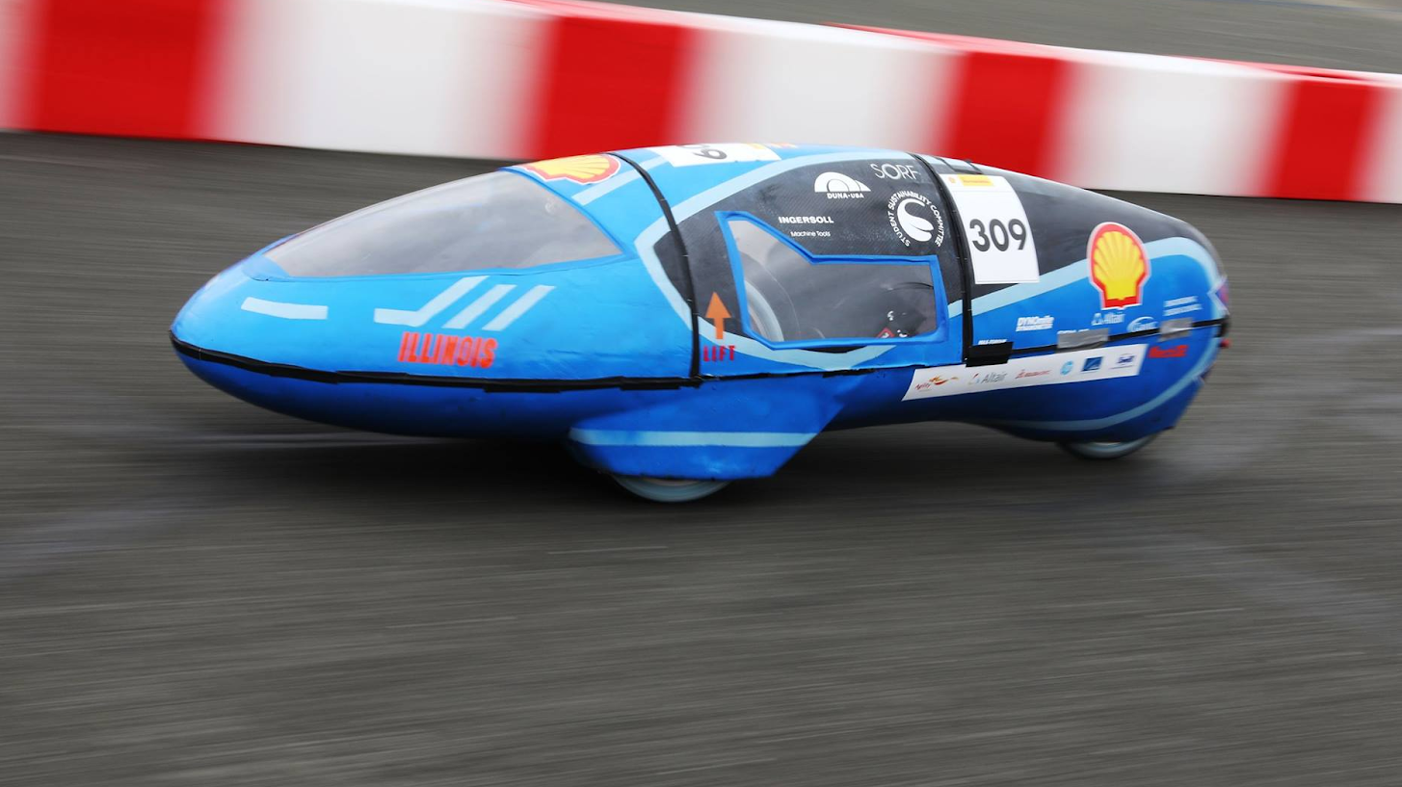

Eco Illini Supermileage
Week:
4/13/2020

Slide 2
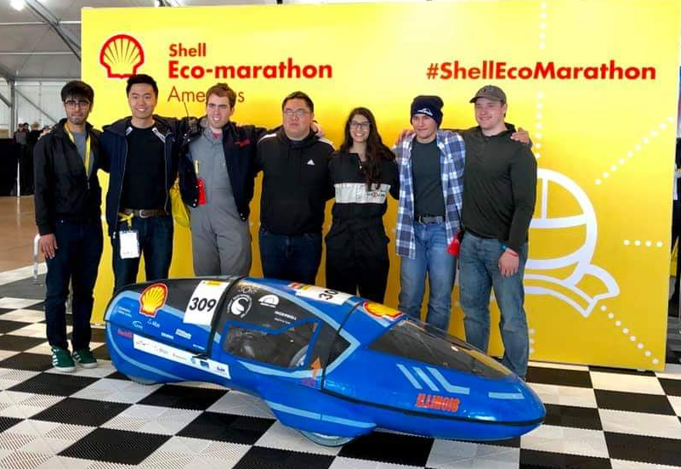
Timeline
Goals for the week:
Timeline of Big Dates
Website Work Continues
  Structure Set
  Content in place – 4/19/20
  As polished as possible, review by 5/2/20
ELT 20/21 Meeting
This week in review (TWIR):
Interviews for open positions held
  Mechanical lead, Dynamics Lead, Testing Lead
Website details "finalized"
In need of treasurer

Slide 3
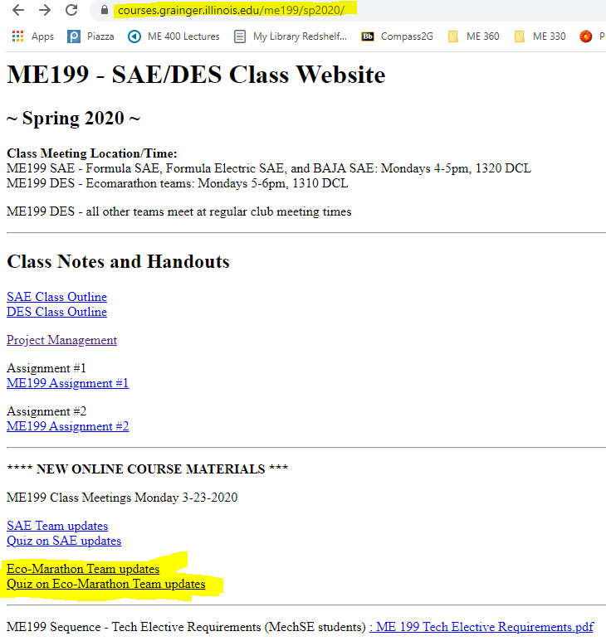
ME 199 and Class Participation
In-class participation suspended
Meetings temporarily on hold
Course Evaluation: (How we will evaluate/give you a grade)
Participation on projects/planning through the rest of SP 2020
Completed CAD Assemblies of projects
  Email skamzol2@Illinois.edu for Solidworks
  If unable to run, see below
Team Wiki:
  Post project work, information/research, methods towards completing your project, and status of project → Why did you do what you did???
  List where future development could be made (if any)
Paper: Write conclusion of where project is left at, steps needed to finish it, and rough time needed to assemble/test
Attendance: Take “Quiz”; based on these PPT’s!

Slide 4

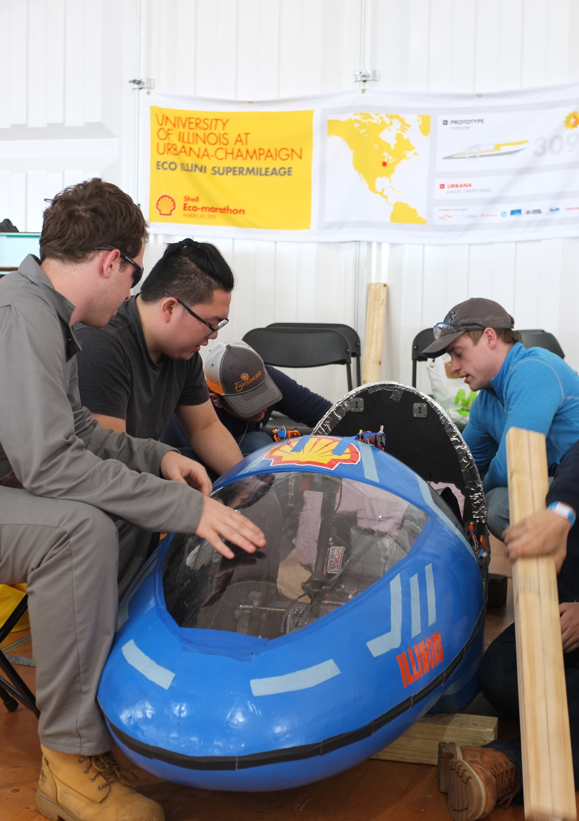
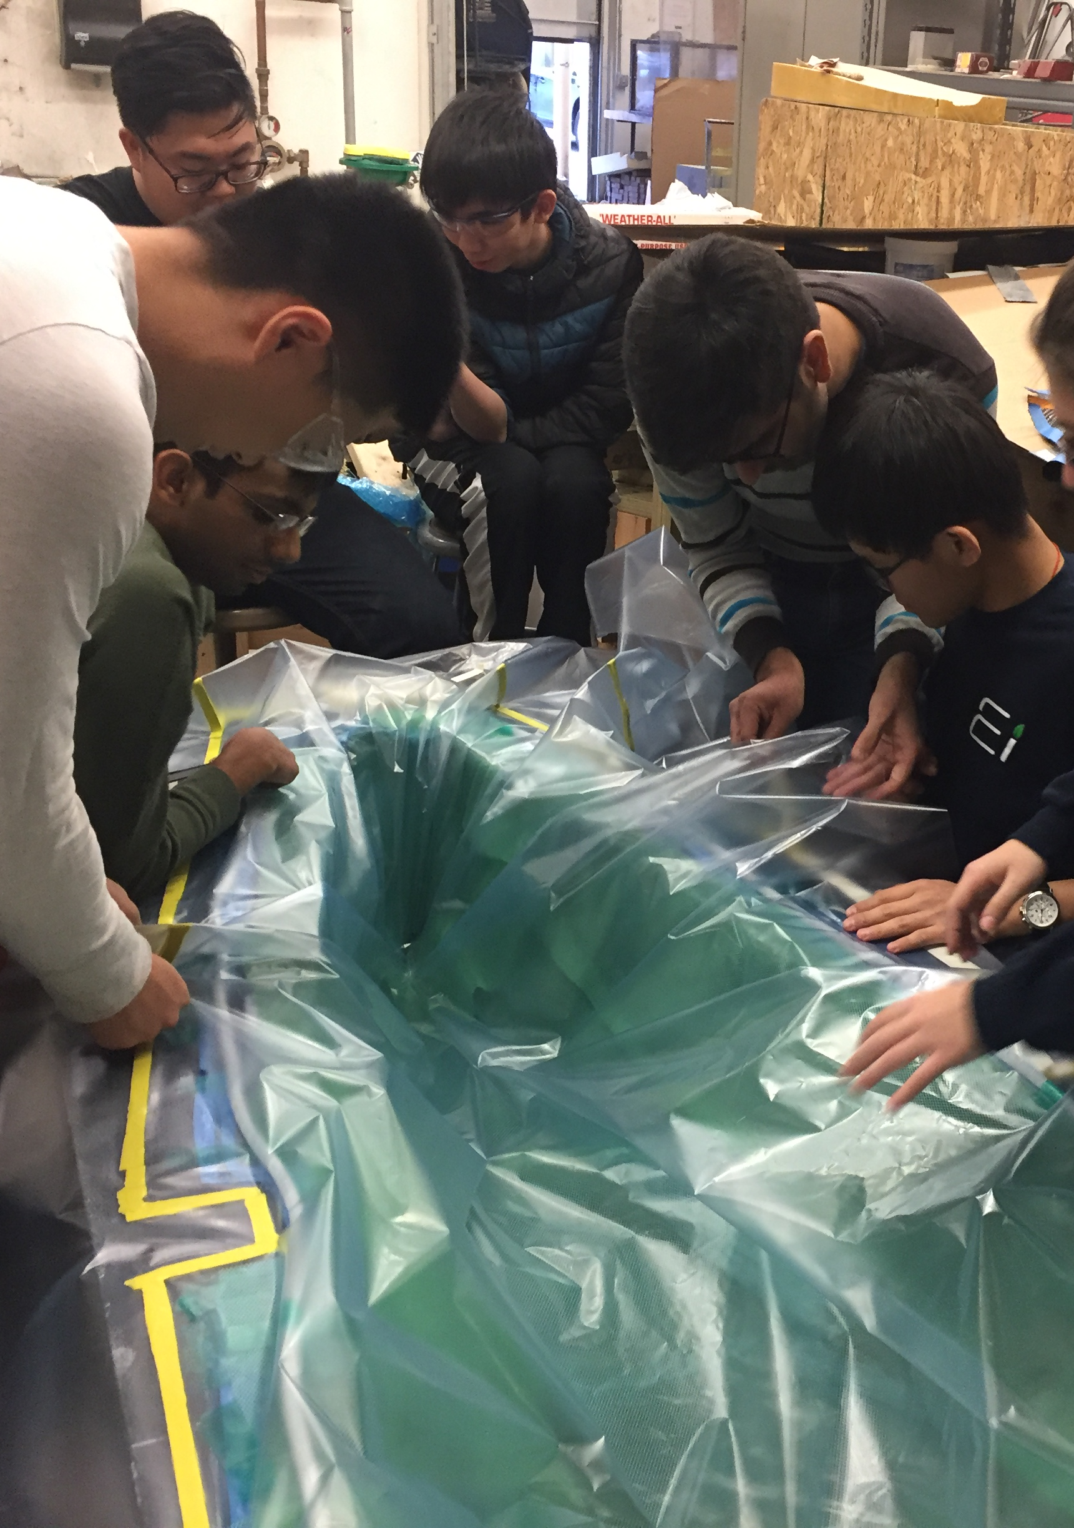
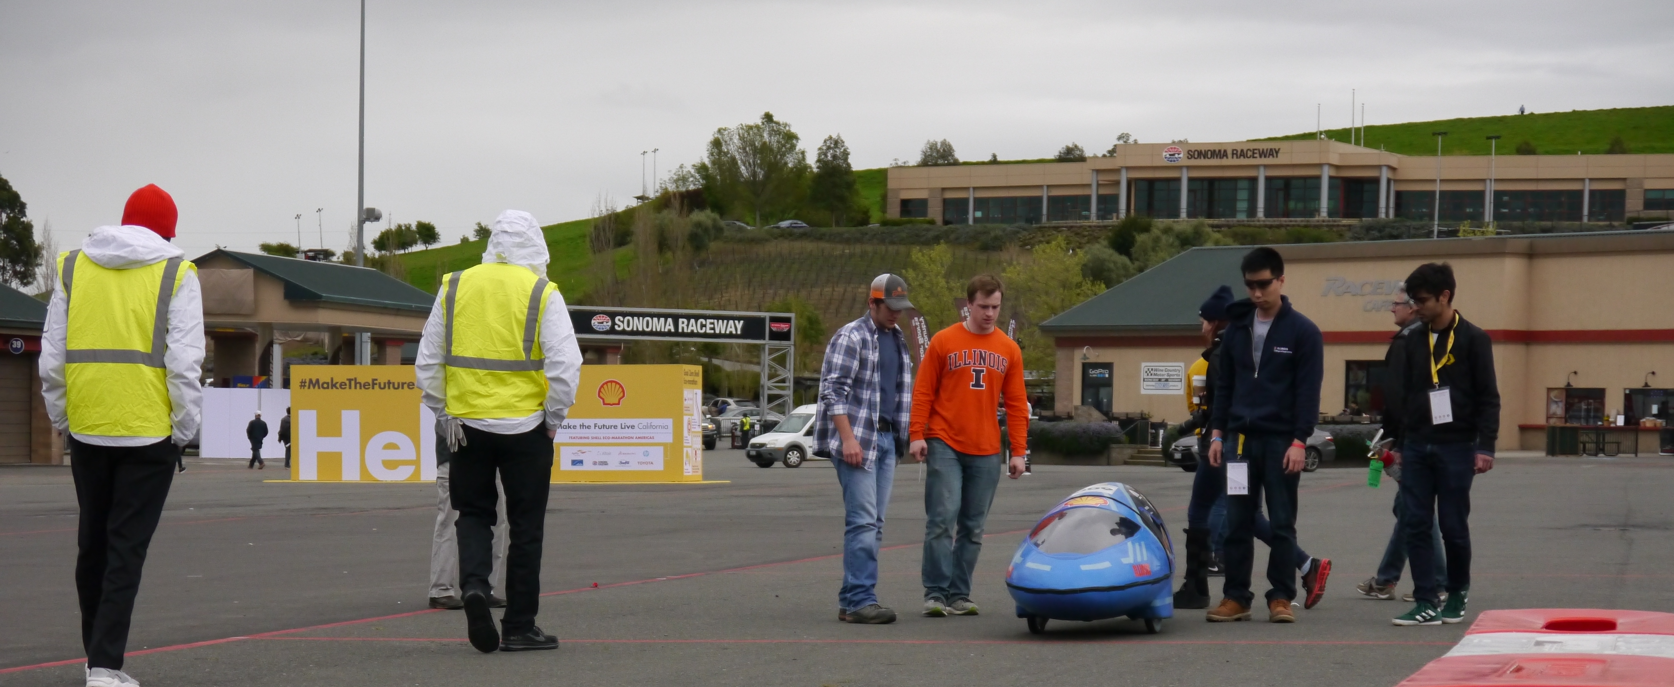
Mechanical

Slide 5
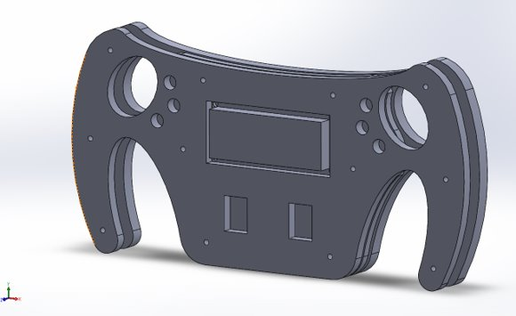
Mechanical
Working on assemblies
  Design new gear for electrics drivetrain
Mechanical Subteam arrangement for next year
  Goal: Place specialists in charge of different critical subgroups
  Workflow plans managed between subsystem and specialist leads
  Keep members engaged and provide central contact/chain for development
Structure for 2020-2021
Mechanical Lead
  Engine Lead
  Dynamics Lead (Brakes/Steering)
  Testing Lead

Slide 6
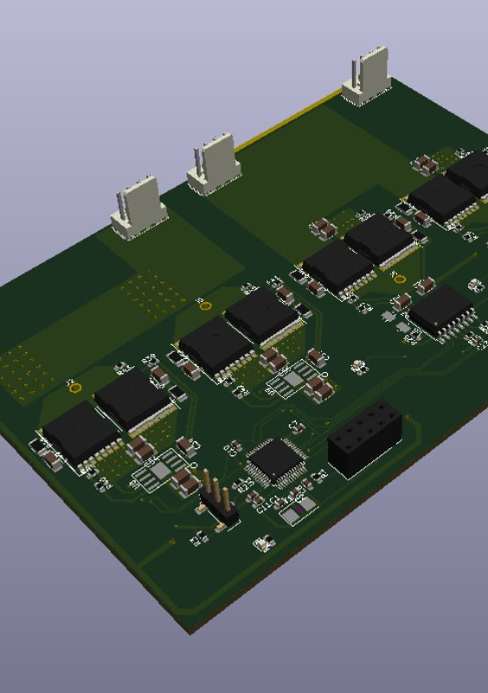
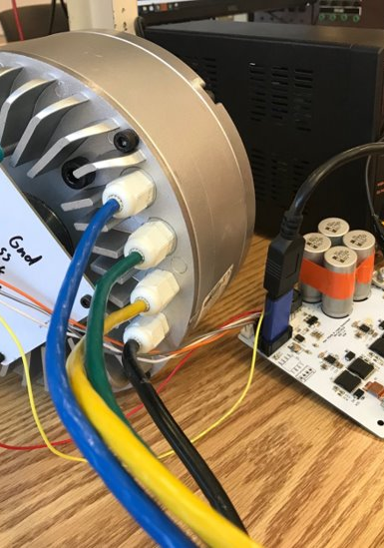
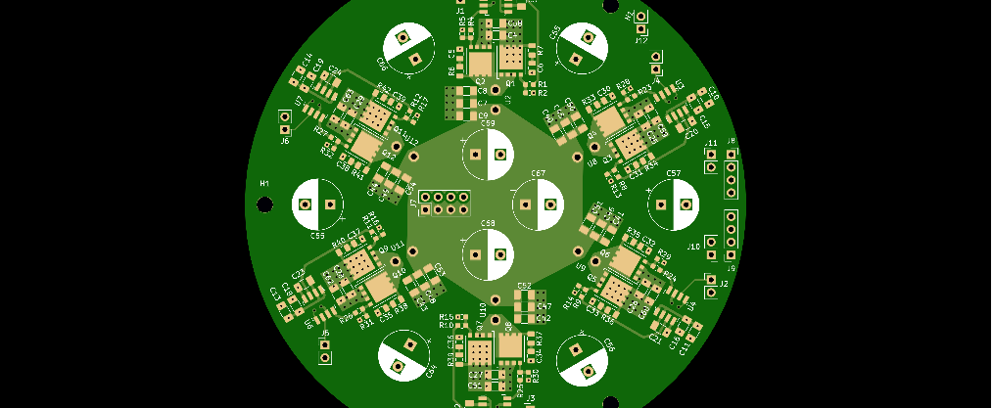
Electrical

Slide 7
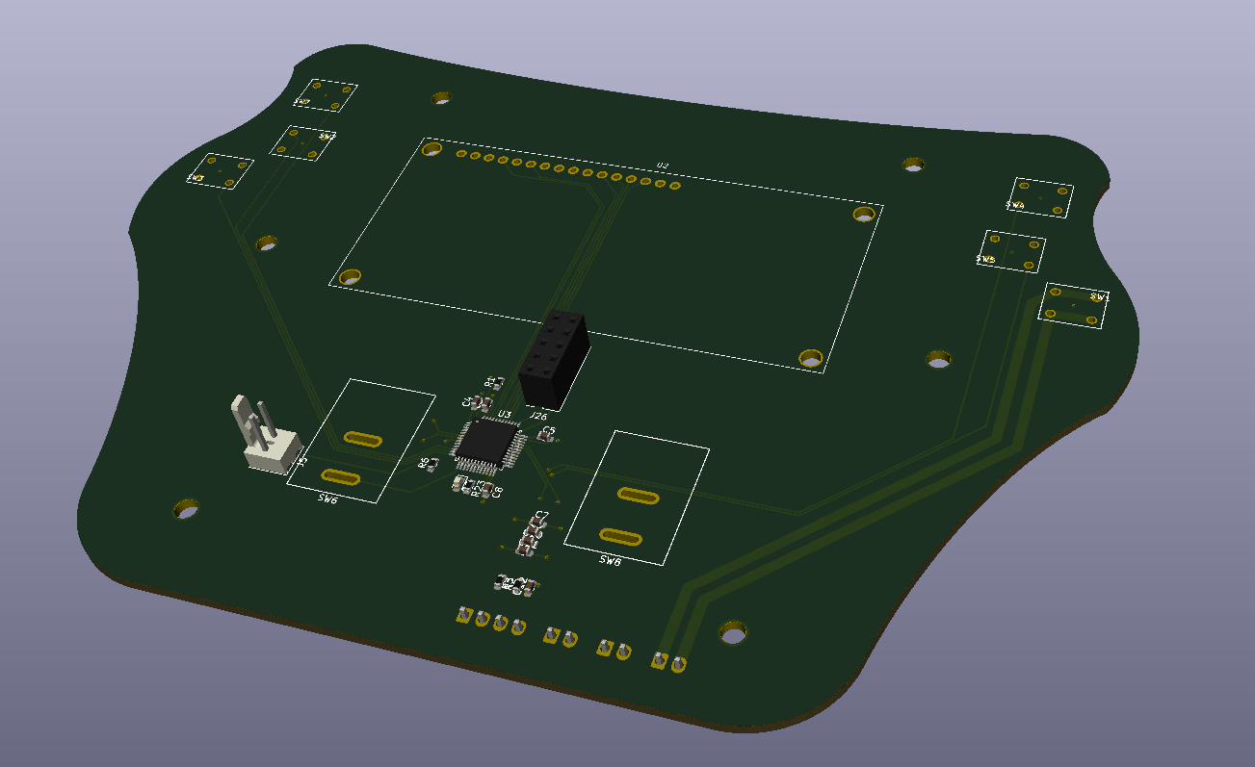
Electrical
Shifting gears from electrical to gas for SAE
Battery manufactured
Steering wheel pcb design
Working on motor mounting issues
Moving back to shelved projects
Alex moves to joint-Eco lead developer
New Electrics subteam lead

Slide 8
Manufacturing

Slide 9
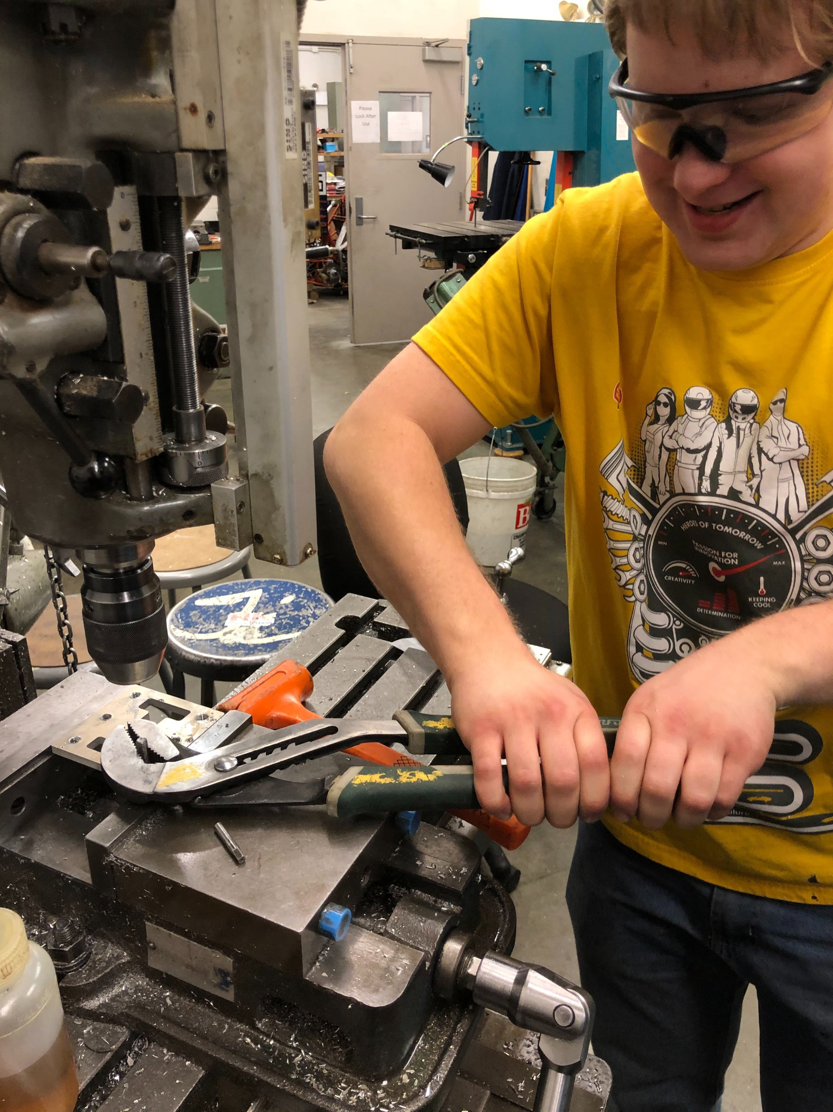
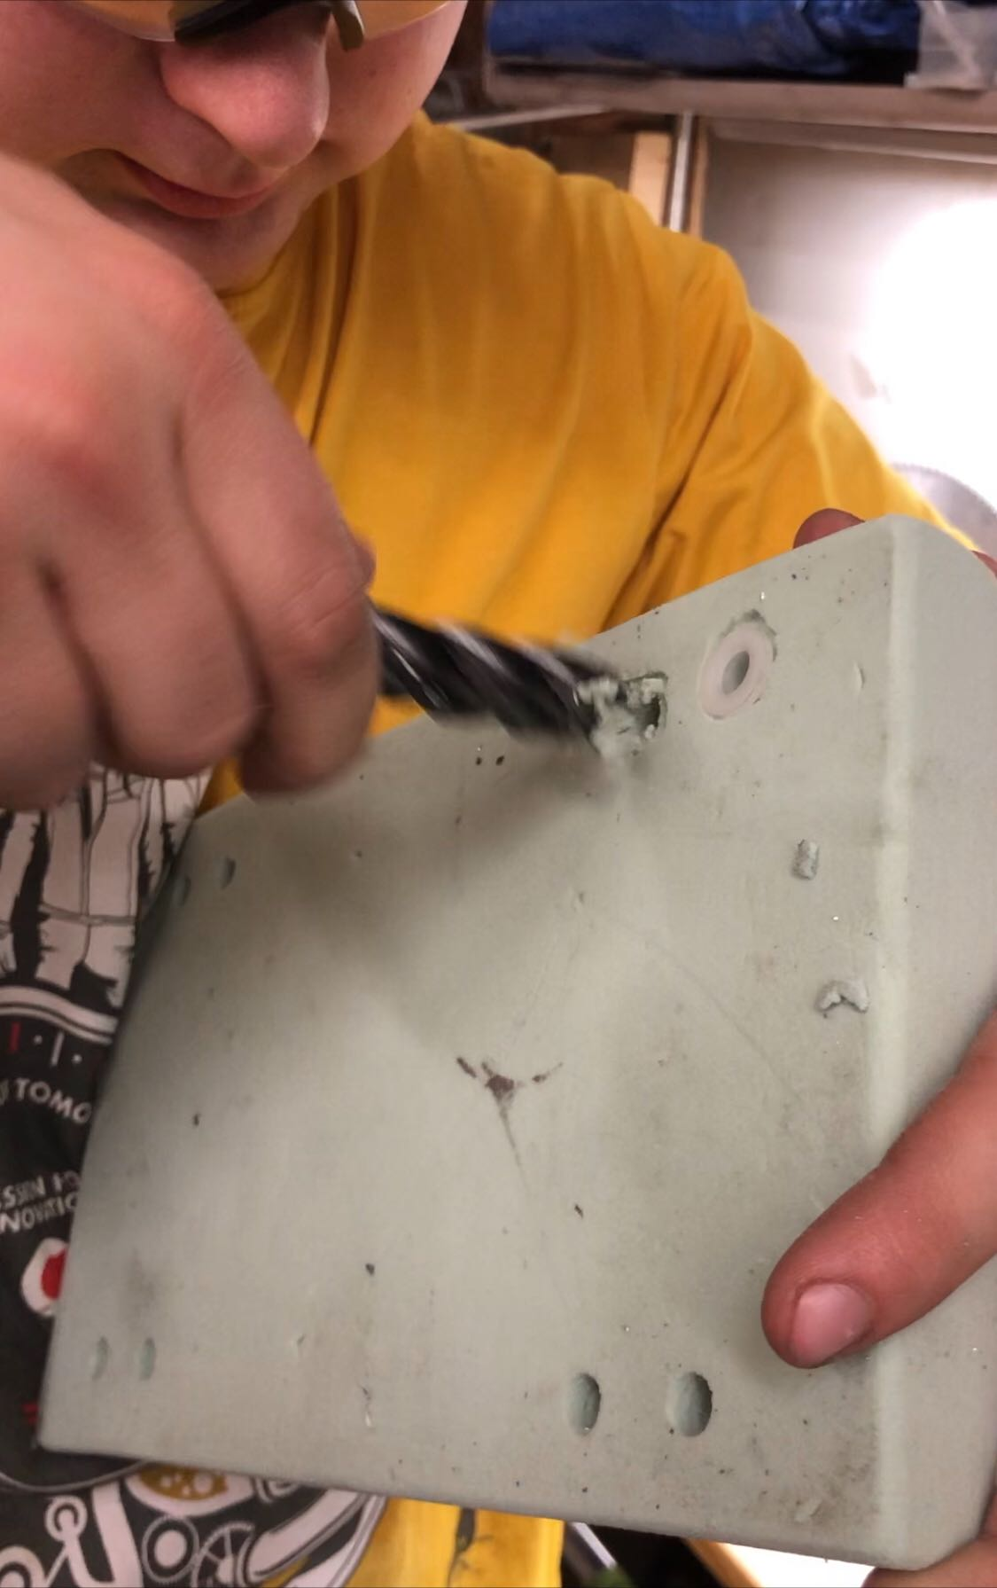
Progress
Waterjet – 98% (need new gear)
Machining: ~85% complete
Welding: ~50% complete
Highlights
  Rolling car ready

Slide 10
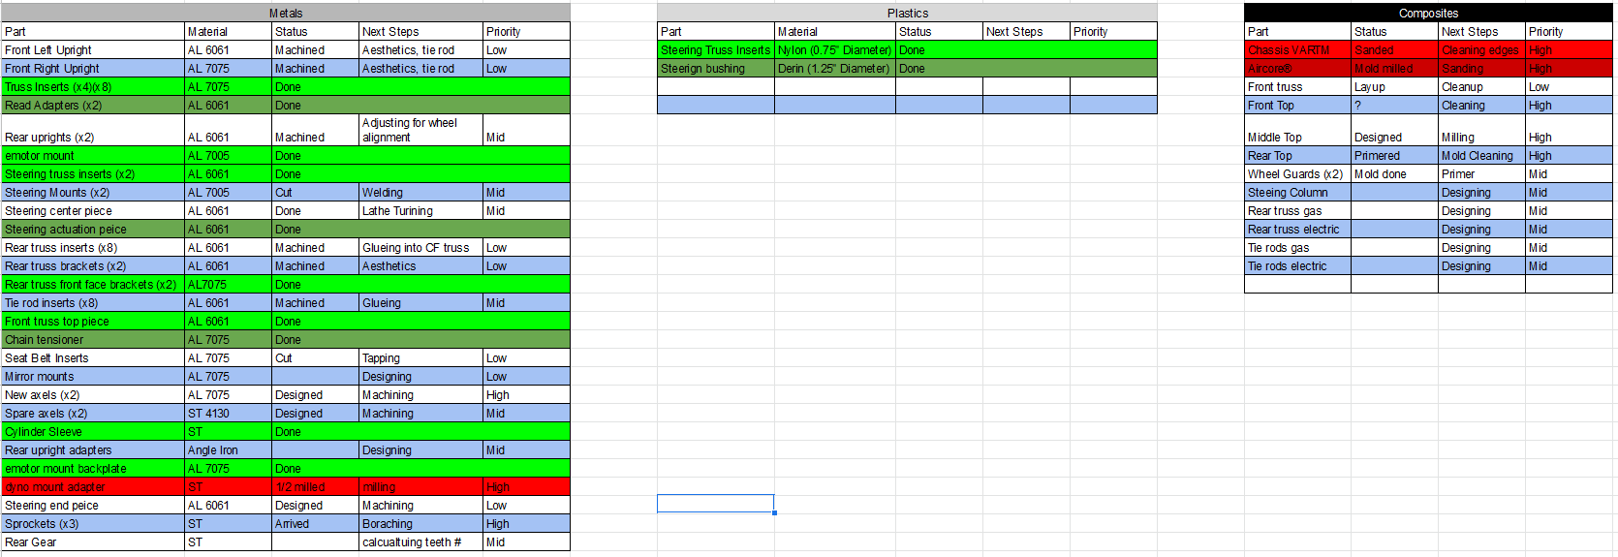
Manufacturing

Slide 11


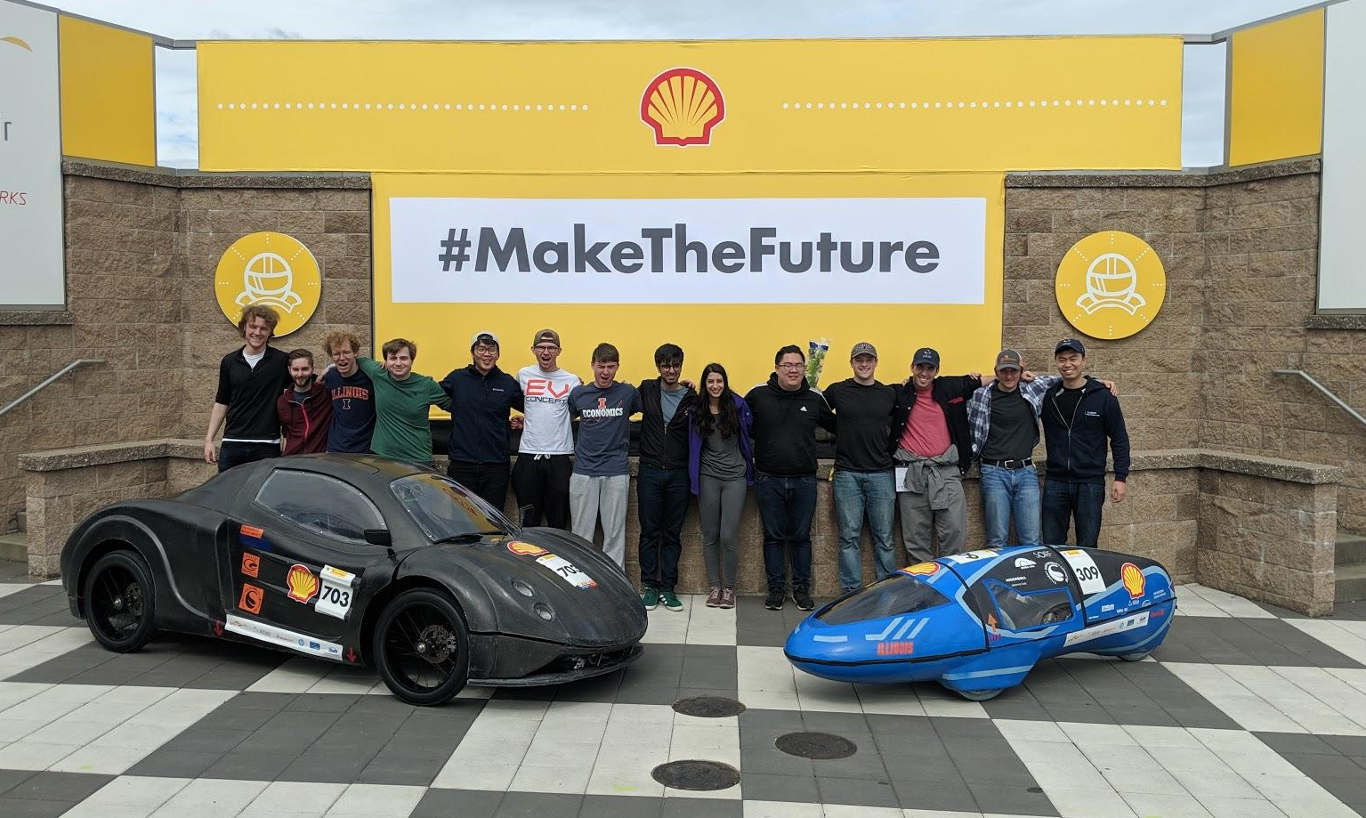


Slide 12
Mechanical Team - Robert Mauge
Researching ways to further improve mechanical systems
  Accelerometer and strain gauge to determine stresses on chassis and suspension
  DFA for entire car suspension and chassis
  Improvements to the steering rack and pinion
  New ways to connect the steering rod to the uprights
Starting mechanical meetings again this Saturday
  Slides are prepared and ready to go

Slide 13
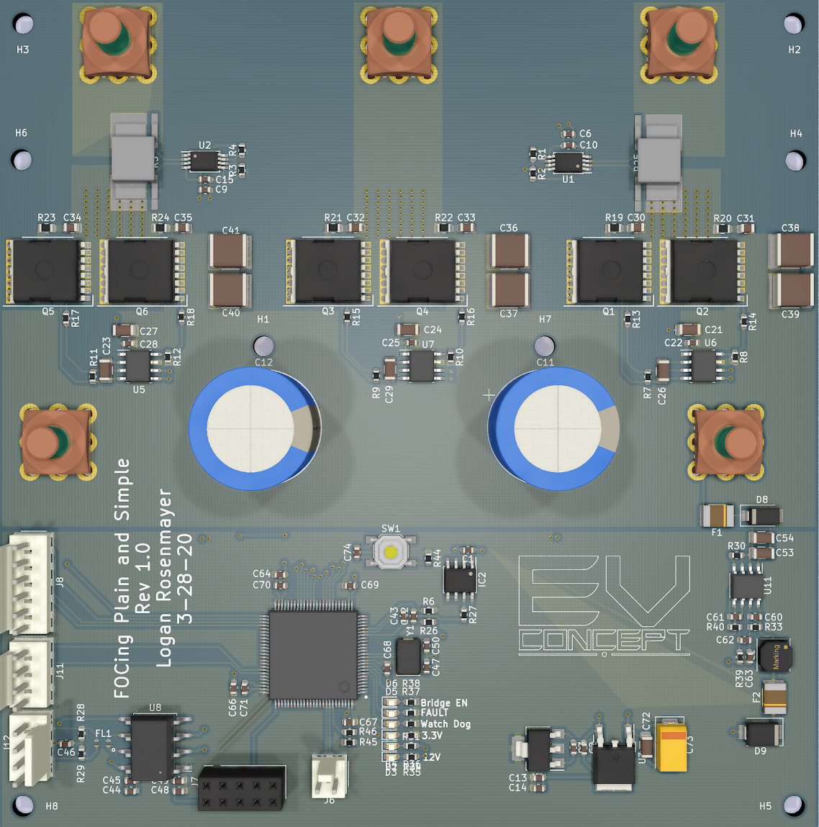
Electronics Team - Moving the Car
Redesigning the motor controller- Reduced cost by $40
  Continuing redesign
    Using STM32’s built in ADCs
      H7 series has built in oversampling
      Replaces most expensive part
  Removed overkill linreg
    Replacement is cheaper and easier to solder
Electronics meetings will be crash courses on critical topics for the team not taught in class
  Zoom meetings that are recorded (Logan Lectures)
    Format: Premade slide decks
  Covers concepts and math used in designing
  Topics: Motor control, Li-Ion batteries, STM32 coding (2 lectures each)
  Lectures recorded and uploaded to our Google Drive

Slide 14
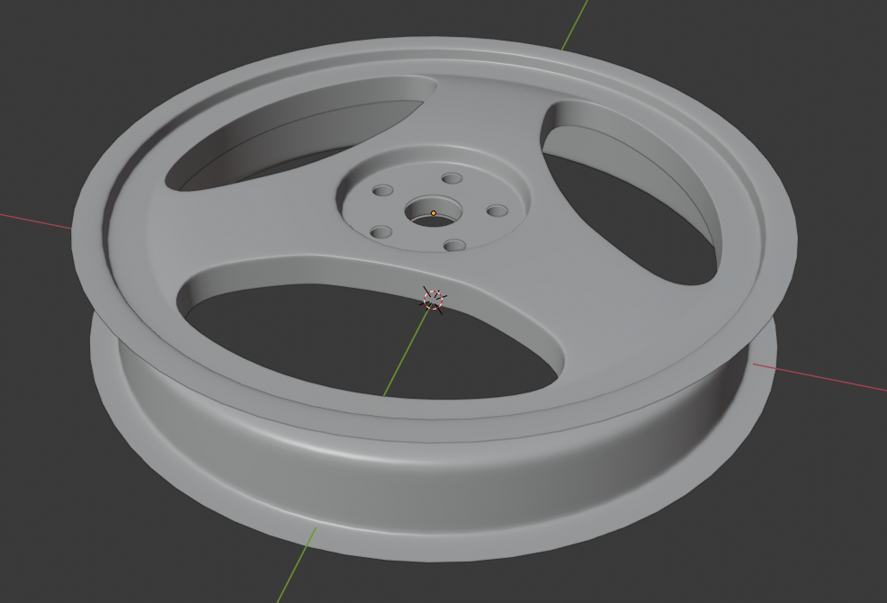
Composites Team - Richard Mauge
Switched from 8 spoke to 3 spoke
  Significantly easier to manufacture and prepare
Need to reanalyze the rim to confirm which carbon fiber layout to use
  Layup from 0 45 -45 0 vs. 0 60 - 60
  Need to confirm if fibers running parallel with the spokes will reduce its strength
Documentation coming along well
  Chemicals
  Carbon fiber layups
  Mold manufacturing

Slide 15
Financials - Richard Mauge
Discovered many accounting discrepancies between our accounting and MEB financial office’s accounting
  Already discovered $3,000 charge from VR3 Engineering for tube bending (business office charged other teams expense to our account)
Shell Eco-Marathon travel stipend still not added ($2,000)
Full scale investigation into the last 4 years of money spent and received in conjunction with MEB financial office

